Slide 1
Introduction to HTML5 and CSS3: Day 3 Dr. Naveen Kumar, BES-1

Slide 2
Agenda
HTML Document
Basic Structure of HTML Document
Creating HTML Document
Basic HTML elements
HTML element with Attributes
Line break (vertical and horizontal) and HTML tags
Style Attribute

Slide 3
Computer Code <code>
Keyboard Text <kbd>
Programming Variables <var> together with <code> or <pre>
Program Output <samp>

Slide 4
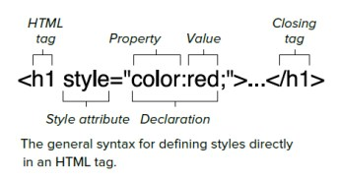
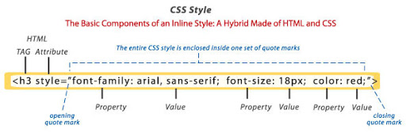
The Style Attribute

Slide 5
The Style Attribute (cont.)
<tagname style="property:value;">
Background Color
<p style="background-color:powderblue;">…</p>
Set background color for two different elements:
Text Color
<h1 style="color:blue;">This is a heading</h1> <p style="color:red;">This is a paragraph.</p>
Fonts
<h1 style="font-family:verdana;">This is a heading</h1> <p style="font-family:courier;">This is a paragraph.</p>

Slide 6
The Style Attribute (cont.)
Text Size
<h1 style="font-size:300%;">This is a heading</h1> <p style="font-size:160%;">This is a paragraph.</p>
Text Alignment
<h1 style="text-align:center;">Centered Heading</h1> <p style="text-align:center;">Centered paragraph.</p>

Slide 7
Style Summary
Use the style attribute for styling HTML elements
Use background-color for background color
Use color for text colors
Use font-family for text fonts
Use font-size for text sizes
Use text-align for text alignment

Slide 8
Image in HTML

Slide 9
List and Table
Unordered List
Ordered List

Slide 10
Table in HTML

Slide 11
Thank you

